Slide 1
Dimensionality reduction
PCA and tSNE

Slide 2

Dimensionality reduction in ML
High-dimensional spaces are inherently difficult for humans to develop a clear intuition for
Is there an intrinsic manifold within the dataset?
Features
[ ]
X =
Observations

Slide 3

Dimensionality reduction techniques
Many variables, many samples (variety of processes)
Not intuitive
(for human)
Limited number of influential variables
Reduce dimensionality of data to make it more intuitive to understand
Humans good (too good) at picking out patters: use statistical approaches
Question
What kind of structure is there in my dataset?
(BBC news, 15 June 2017)

Slide 4
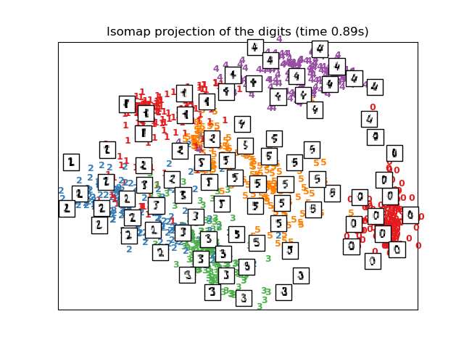
Dimensionality reduction techniques

Slide 5
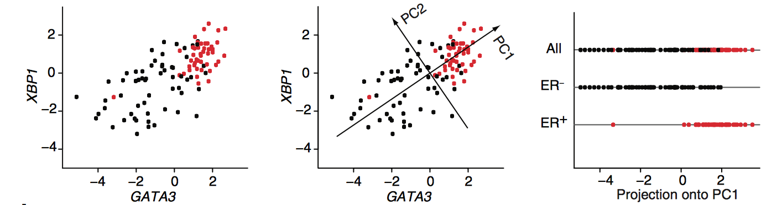
Principle component analysis (PCA)
Principle Component analysis (PCA) is a linear dimensionality reduction technique (Pearson, 1901; Hotelling 1930)
Identifies a new co-ordinate system to represent the data
New axis are the principle component (PC) axes
First principle component (PC1) explains the greatest amount of variation, second principle component (PC2) explains the second greatest amount of variation …
Dimensionality reduction occurs when we discard higher principle components e.g., only the first two PCs
(Ringnér, 2008)

Slide 6
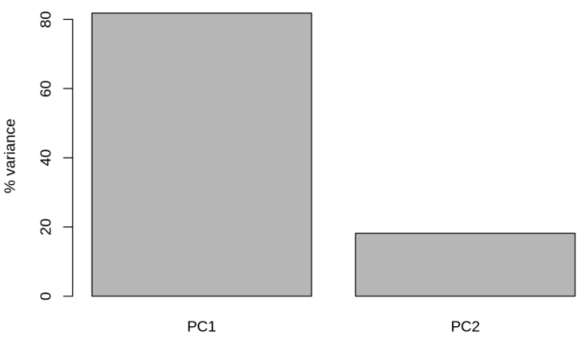
Principle component analysis (PCA)
(Ringnér, 2008)

Slide 7
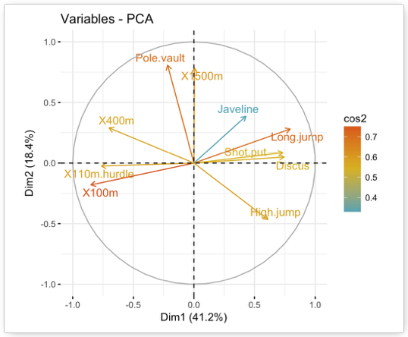
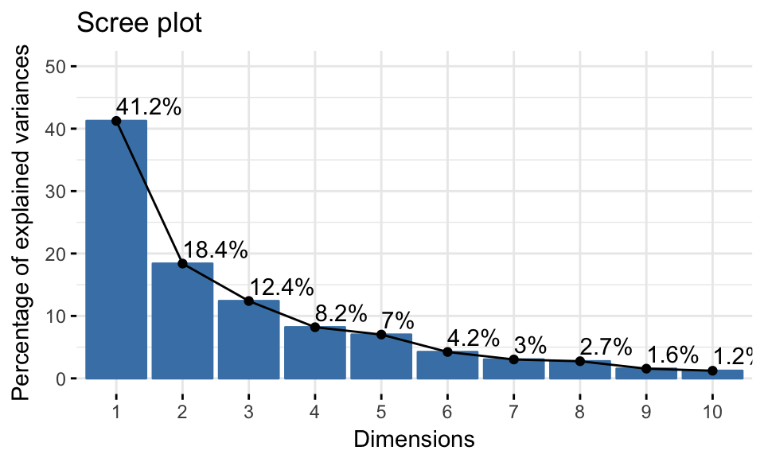
Principle component analysis (PCA)
Elbow
Notes:
http://www.sthda.com/english/articles/31-principal-component-methods-in-r-practical-guide/112-pca-principal-component-analysis-essentials/

Slide 8
Principle component analysis (PCA)
Y <- prcomp(X, scale = FALSE, centre = TRUE)
PSEUDOCODE

Slide 9
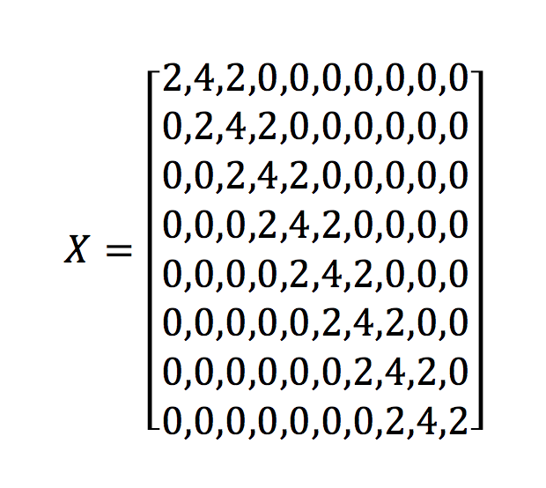
The horseshoe effect
PCA is a linear dimensionality reduction technique
Problem with nonlinearities in the data
The horseshoe effect (Novembre & Stephens 2008, Reich et al. 2008)
time
genes

Slide 10
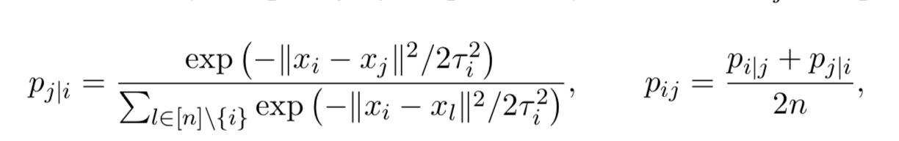
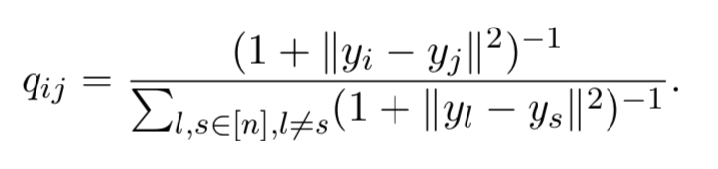
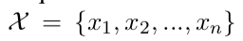
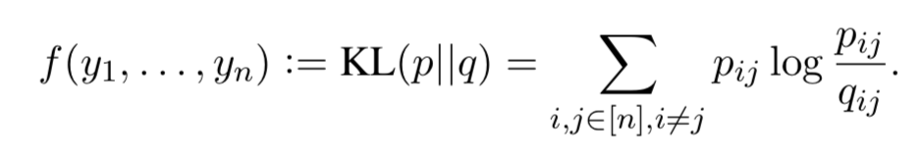
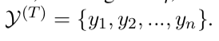
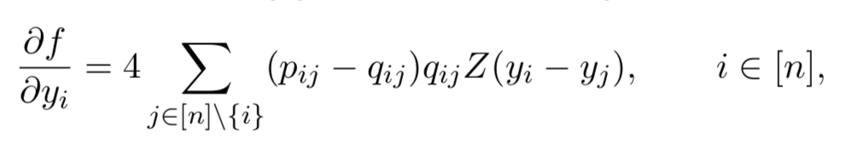
T-distributed stochastic neighbor embedding
T-distributed stochastic neighbor embedding (tSNE, Maaten and Hinton, 2008)
Nonlinear dimensionality reduction
Have some high dimensional input space:
Map to a low dimensional space:

Slide 11

T-distributed stochastic neighbor embedding

Slide 12
T-distributed stochastic neighbor embedding
Attempts to conserve distance between nearby objects (in reduced dimensional space)
Initialise using e.g., PCA
Perplexity parameter
PSEUDOCODE
Y <- Rtsne(X, k = 2, initial_dims = D, perplexity = 50)

Slide 13
T-distributed stochastic neighbor embedding
Stochastic
If you run it twice, the results will differ
Can check the results are robust

Slide 14
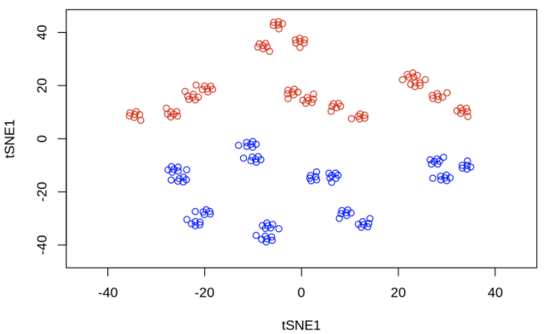
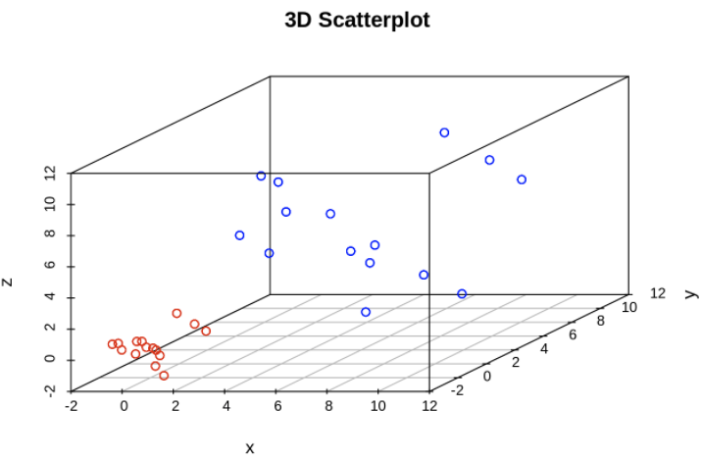
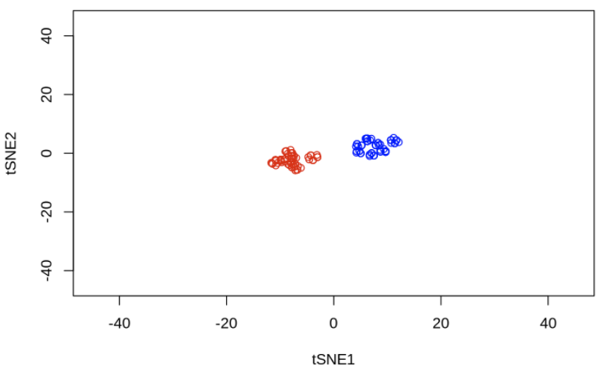
T-distributed stochastic neighbor embedding
Perplexity = 10
Perplexity = 50

Slide 15
T-distributed stochastic neighbor embedding
Perplexity parameter:
Local versus global aspects of data
Evaluate by eye? Metrics for automatically choosing perplexity (Cao and Wang, 2017)

Slide 16
Summary: dimensionality reduction techniques
Principle component analysis
Good start point for large datasets
Not (always) appropriate for nonlinear data (horseshoe effect)
Axis (usually) have an interpretation
Biological intuition

Slide 17
Summary: dimensionality reduction techniques
T-distributed stochastic neighbor embedding
Nonlinear dimensionality reduction
Perplexity parameter:
Random data can appear to have structure
Size of a cluster doesn’t necessarily have any relationship to variance
What do the axes in nonlinear dimensionality mean?
T-SNE is … particularly well suited for the visualization of high-dimensional datasets
Outliers … were identified by t-SNE dimensionality reduction
X

Slide 18
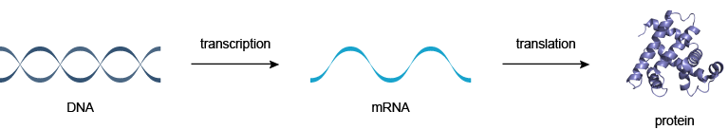
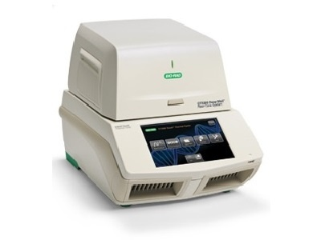
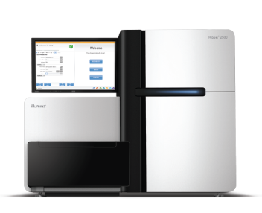
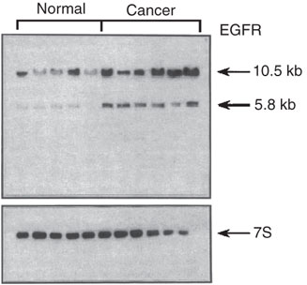
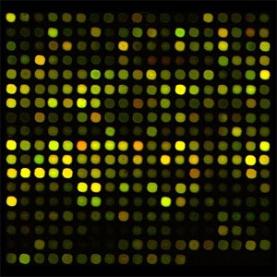
Task
Gene expression
Protein expression
70’s
80’s
00’s

Slide 19
Transcriptomics
Gene expression
Protein expression
Many variables (genes) but few observations (large p, small n)

Slide 20
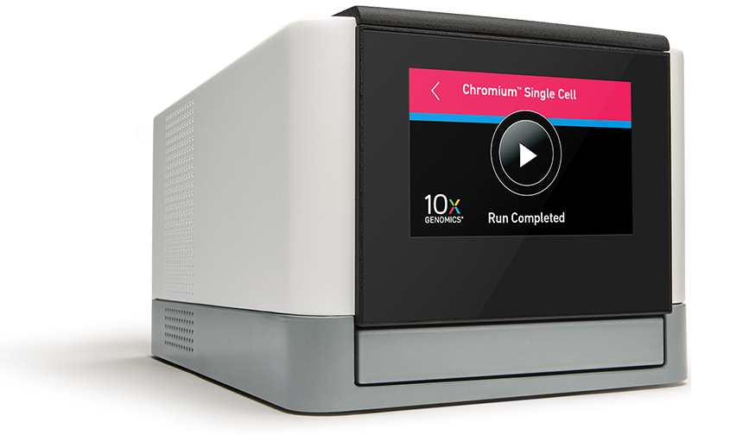
Transcriptomics
Gene expression
Protein expression
70’s
80’s
00’s
10’s

Slide 21
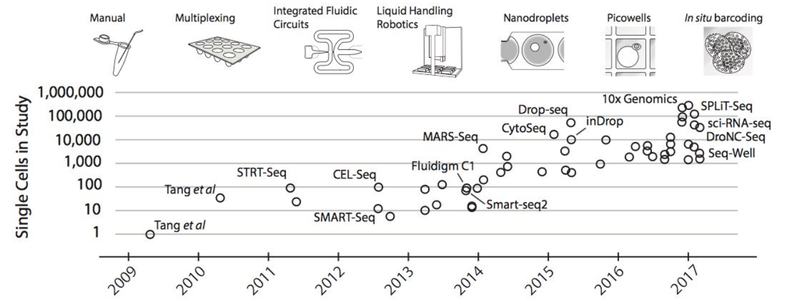
Single cell transcriptomics
Svensson (2017)
70’s
80’s
00’s
10’s

Slide 22
Single cell transcriptomics
Mouse gastrulation
Zebrafish and Xenopus whole embryo development
Many variables (genes) and many observations (large p, large n)

Slide 24
Features
For each cell we measure the levels of 2957 genes
Around 400 cells
Use dimensionality reduction (PCA/tSNE) to identify structure within the dataset i.e., identify cell types and genes that summarise the differences in cell types
[ ]
X =
Observations
Our data X is a (452 x 2957) matrix

Slide 25
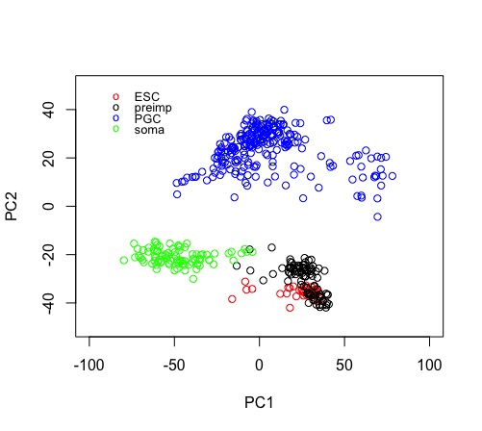
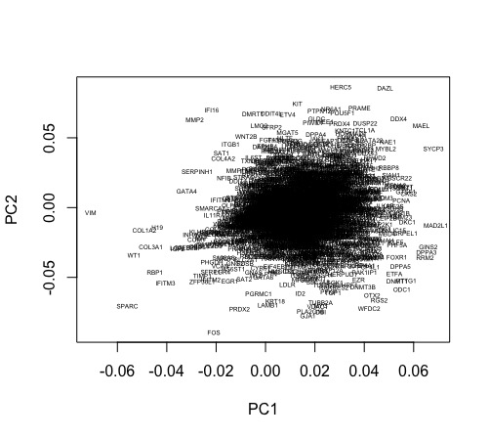
pcaresult <- prcomp(t(D[4:nrow(D),1:ncol(D)]), center = TRUE, scale. = FALSE)
plot(pcaresult$x[,1:2])
plot(pcaresult$rotation[,1:2],type="n")
text(pcaresult$rotation[,1:2], genenames, cex = .4)

Slide 26
